Slide 1
Welcome
To my presentation

Slide 2

Presentation on:
Network establishment, monitoring and troubleshooting of ANL (aamra networks limited)
Presented by-
Rifatul Islam Himel
ID # 10105128

Slide 3
Contents:
Introduction
Organization overview
ANL (aamra networks limited) at a glance
Mission and vision
Network coverage
Organogram
Services
Technology partner
Network establishment of ANL
Network
Network properties
Network criterion
Network category
Connection types
Network Topology
Project demonstration

Slide 4
Contents (Cont,,,):
Communication protocol
OSI model
Network interface card
Data transmission by NIC
Data reception by NIC
POPs list of ANL
Connectivity
Devices
Configuring
Network monitoring in ANL
Network status monitoring
Network monitoring dash-board
Radio device monitoring
Router checking
Download and upload speed checking
Fiber monitoring

Slide 5
Contents (Cont,,,):
Troubleshooting by ANL
Technical support flowchart
Support call prioritization
Target response and resolution time
Customer relationship management (CRM)
Staff-Customer ratio
Common troubles
Solution
Recommendation
Conclusion

Slide 6
Introduction:
Networking is very interesting profession for engineers. To learn about networking practically, ANL helps its junior engineers a lot. They support them with patience. To establish a new network, we have to know the basics of networking. Specially, we have to know the physical devices and its working procedure. Data communication and networking is fundamental topic of network engineering. The responsibilities of infrastructure engineer of ISP are establishing a new network, monitoring them and troubleshooting. In this presentation, all of them are going to be discusses elaborately.

Slide 7
Organizational overview

Slide 8
ANL (aamra networks limited) at a glance:
ANL is one of the leading ISP companies in Bangladesh. They are official IT partner of BPL (Bangladesh Premier league), Bangladesh games, Bangladesh Brand Forum Seminar 2013 etc.
Orion group, Lafarge group, Southern group, Juki machinery, hotel Sheraton, hotel Raddison, channel Banglavision, Radio today, Daily Somokal, Fuwang food, Stamford university and a lots of garments and manufacturing company are their clients. They provide IT support almost all over Bangladesh.
ANL is upholding ISO 9001:2008 certification for the last 8 years.
Starting in 1985, the group presently has over 500 employees.

Slide 9
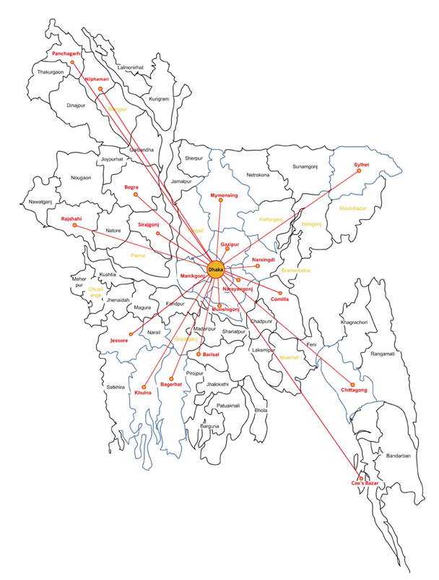
Mission and Vision:
Vision: Excellence and innovation…unlimited … through the power of "WE“.
Mission: To empower our customers, employees, partners and communities by providing the finest products, services and practices.
Network coverage:
Their nationwide backbone covers the regions that are marked on the map:

Slide 10
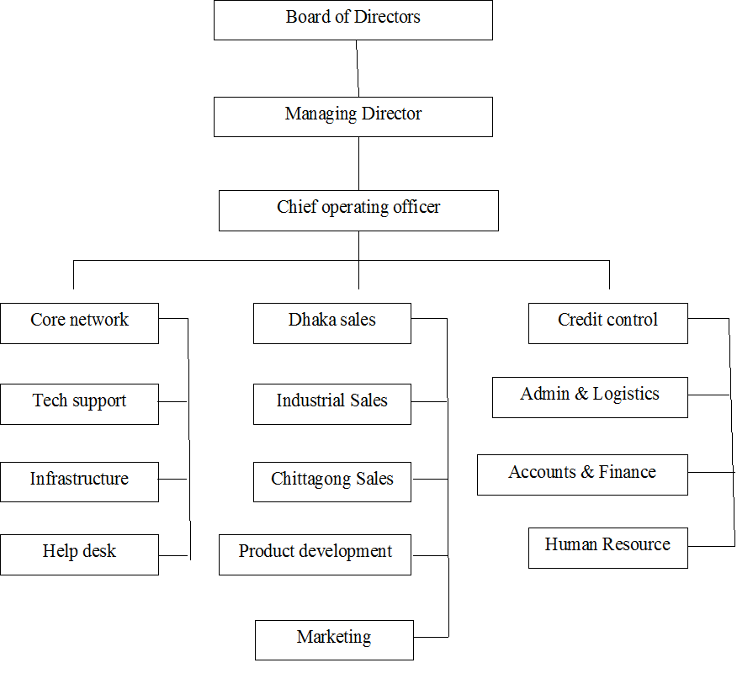
Organogram:

Slide 11
Services:
Infrastructure: Data Connectivity, IPLC & IPVPN, MPLS, NPLC, IT Infrastructure Management.
Bandwidth: Internet, WAN
Software: Employee Management System, Online Survey Solution, Global SMTP, Virtual Office , Network Monitoring Solution, Hosted CRM Solution, Hosted Anti-Spam Firewall
VAS (Value Added Service): Video Surveillance, Collocation Service, Office Suite, Call Centre Service, Video Conferencing, Business Email & Hosting Solution.

Slide 12
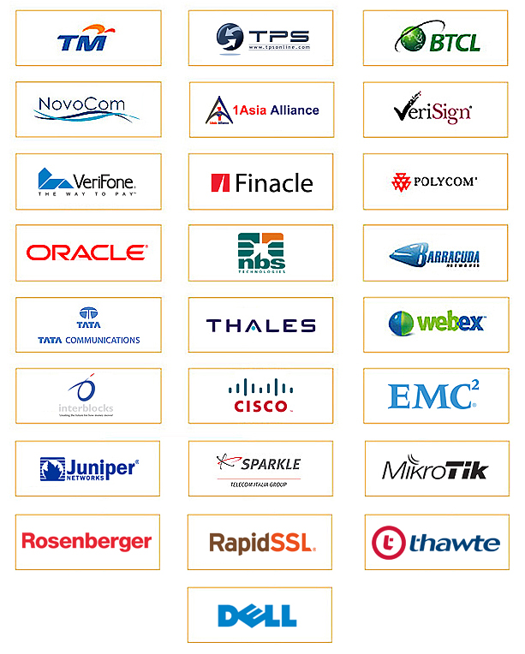
Technology partner:

Slide 13
Network establishment of ANL

Slide 14
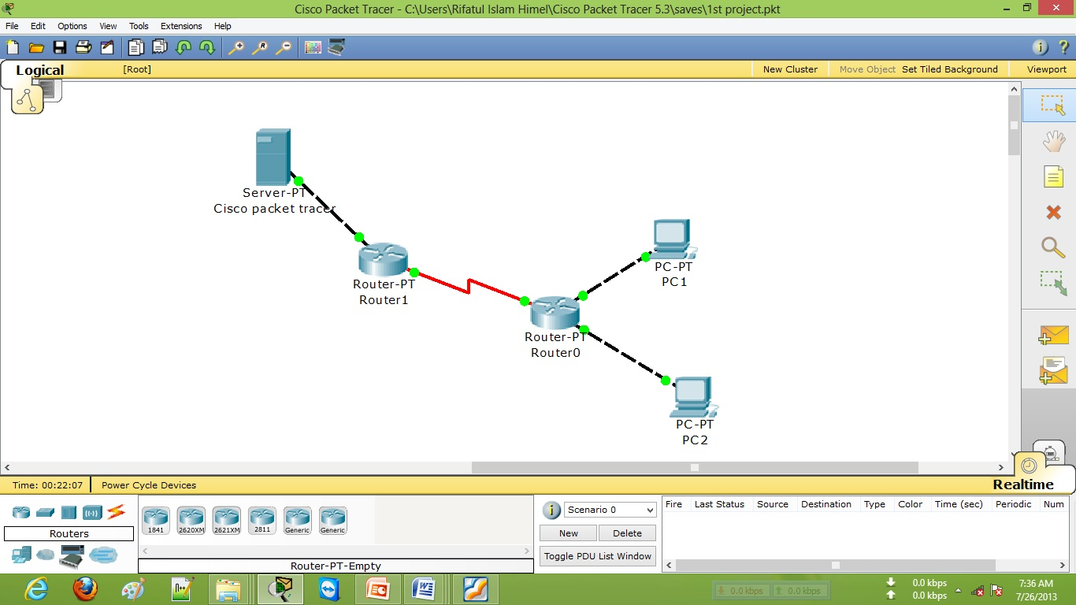
Network:
A network is a set of devices (nodes) connected by media links. A node can be a computer, printer or any other device capable of sending and receiving or only sending or only receiving data generated by other nodes on the network.

Slide 15
Network Properties:
Facilitates interpersonal communications
Allows sharing of files, data, and other types of information
Allows sharing of network and computing resources
May be insecure
May interfere with other technologies
May be difficult to set up

Slide 16
Network Criteria:
Performance
Reliability
Security
Network Category:
Local area network (LAN)
Metropolitan area network (MAN) and
Wide area network (WAN)

Slide 17
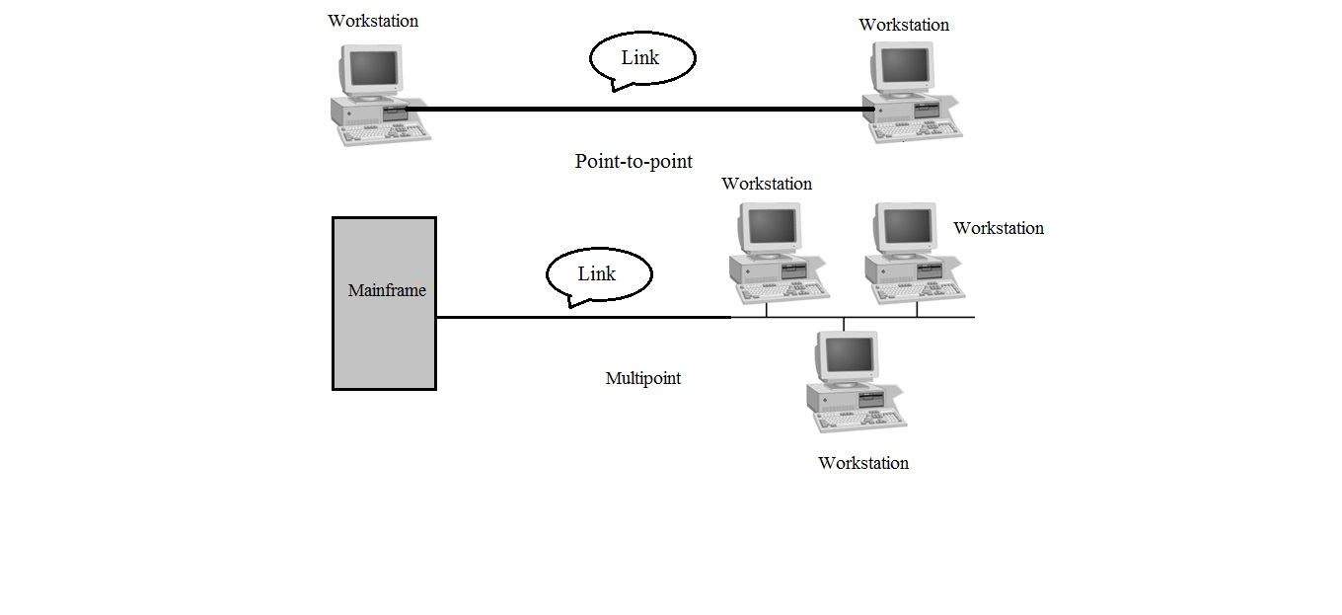
Connection types:
There are two possible types of connection:
1. Point-to-point connection
2. Multipoint connection

Slide 18
Network topology:
Bus
Star
Ring or circular
Mesh
Tree
Hybrid
Daisy chain

Slide 19
Project demonstration:
POP to single client network:
My project:

Slide 20
Communication protocol:
Ethernet
Internet Protocol Suite
SONET/SDH
Asynchronous Transfer mode

Slide 21
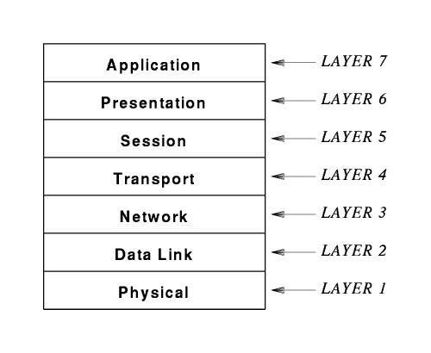
OSI model:

Slide 22
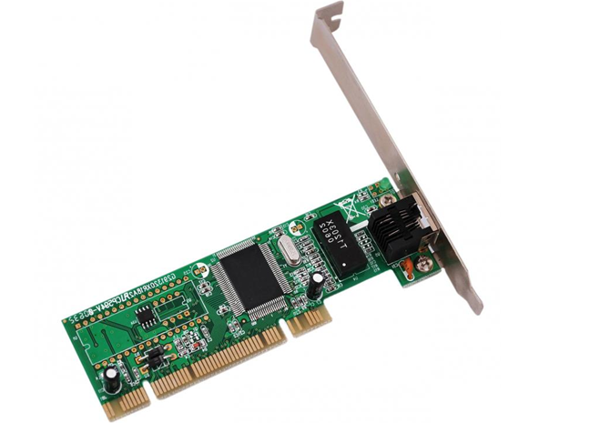
Network Interface Card :
A Network Interface Card (NIC) is a device that allows computers to be joined together in a network, typically a Local Area Network (LAN). Networked computers communicate with each other using a particular protocol or agreed-upon language for transmitting data packets between the different machines or "nodes."

Slide 23
Data transmission by NIC :
CPU forms the data item in memory and instructs NIC to begin transmission. After this, CPU can go back to its other tasks.
NIC grabs the packet in memory and handles the details of accessing the medium and transmitting bits.
When it is done transmitting the data packet, NIC informs the CPU. It uses the “interrupt” mechanism.

Slide 24
Data reception by NIC :
CPU allocates buffer space in memory and instructs the NIC to read the next incoming packet into the buffer.
NIC waits for a packet to cross the network, reads it and checks the destination address.
If the destination’s address matches the computer’s address, NIC reads into the buffer computer’s address, NIC reads into the buffer memory and informs the CPU.
Otherwise, it just discards the packet.

Slide 25
POPs list of ANL:
There are 16 POP of ANL in Dhaka.
10 of them are major POP. Those are –
Safura POP- Banani
BNS POP- Uttara
Gazipur POP- Gazipur Chowrasta (Backbone- Citycell)
Mauna POP (backbone- Citycell)
La vinchi POP- Kawranbazar
Khilgoan POP -Khilgoan
Motijheel POP-Motijheel
AEPZ POP- Adomji
DEPZ POP
NOC POP-Gulshan 2
Minors POP are:
Wintel POP- Gulshan 1
Tejgoan POP- Tejgoan
Bosundhara POP
Baridhara POP
Mirpur POP- Mirpur 1
Stamford POP- Dhanmondi

Slide 26
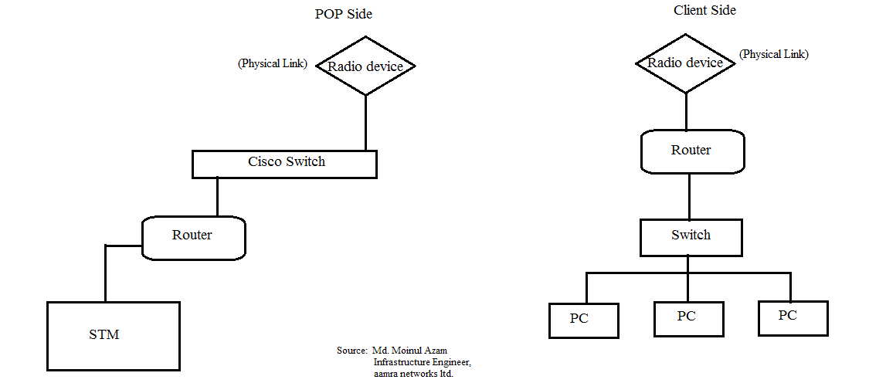
Connectivity:
Two types of connectivity are provided by ANL:
1. Radio connectivity and 2. Fiber optics connectivity
POP to client radio connectivity:

Slide 27
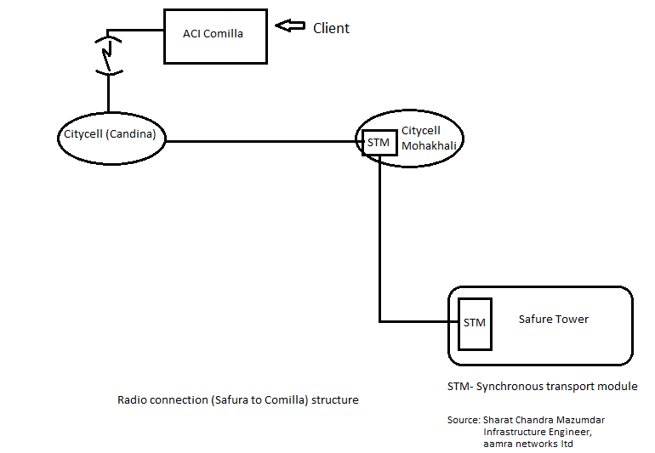
Radio connectivity to clients (outside Dhaka) from ANL:

Slide 28
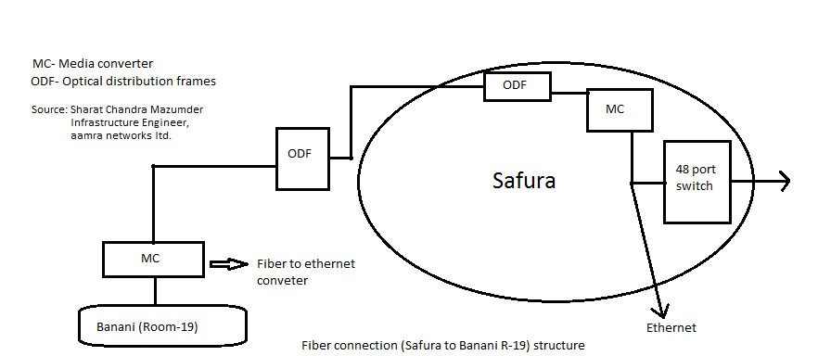
Fiber connection from ANL (Safura tower):

Slide 29
Devices:
To establish a successful network connection, some physical devices are required, such as- radio devices, media converter, E1, bridges, switches, repeaters and hubs, router (microtik), wireless router (netgear), TJB, SFP, Firewall, STM, ODF etc. These are known as hardware components. Now these are going to be described:
Radio devices:
Nanostation, Bullet, Rocket, Canopy, Outdoor radio etc.

Slide 30
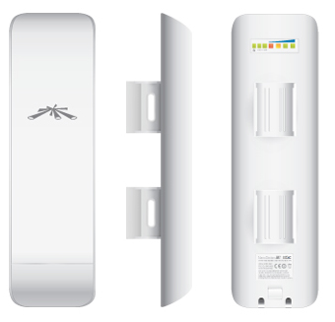

Nanostation:
NSM2 (2.4GHz, 10.4-11.2dBi), NSM3 (3.4-3.7GHz, 12.2-13.7dBi), NSM365 (3.65GHz, 12.2-13.7dBi), NSM5 (5GHz, 14.6-16.1dBi)
Performance Breakthrough:
150+ Mbps real outdoor throughput and up to 15km+ range; Featuring 2x2 MIMO technology, the new NanoStation links significantly faster and farther than ever before

Slide 31
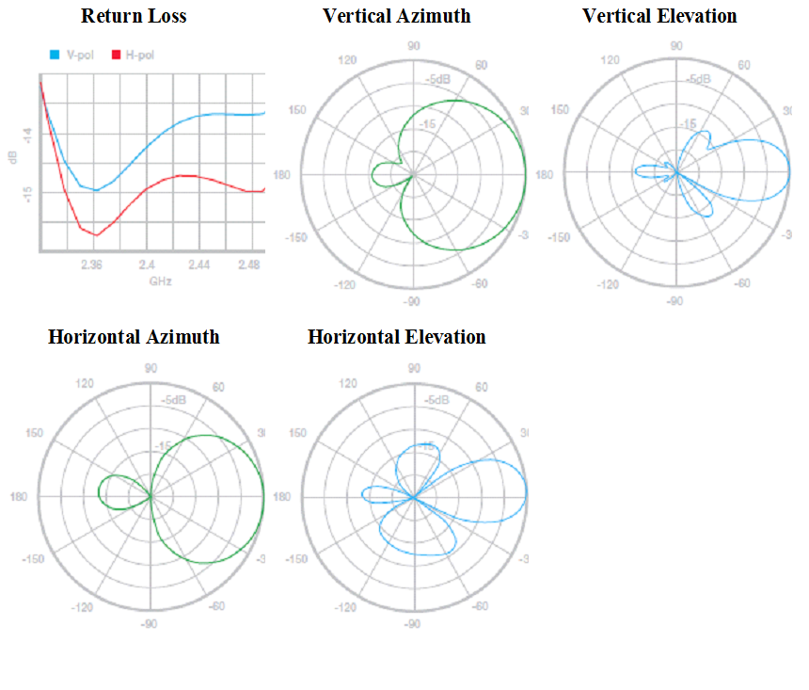
Antenna information of NanoStation M2:

Slide 32
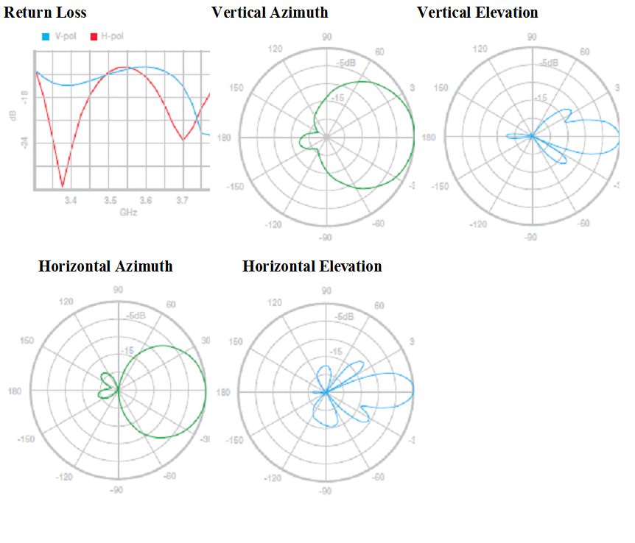
Antenna information of NanoStation M3/M365:

Slide 33
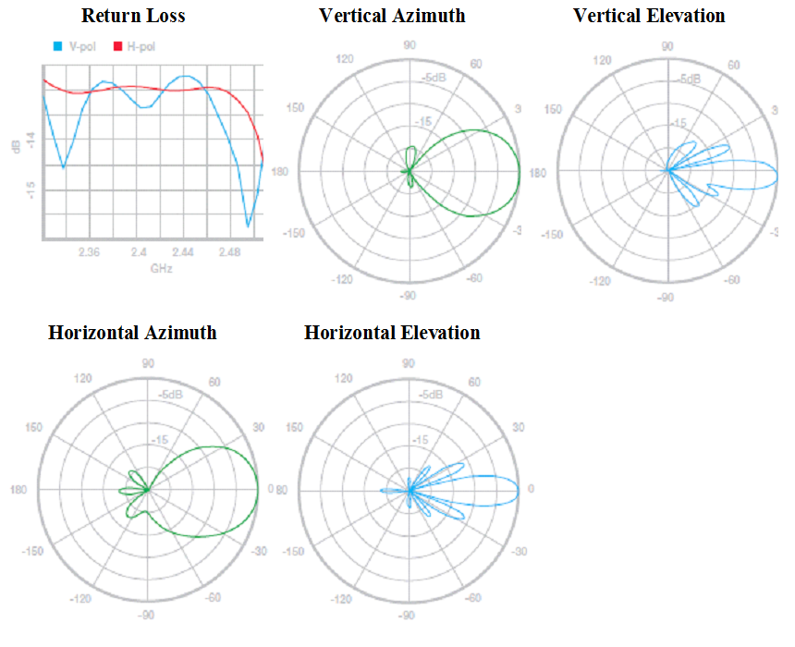
Antenna information of NanoStation M5:

Slide 34
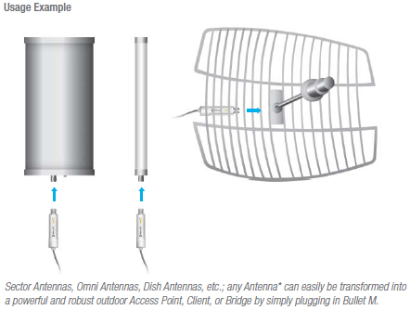
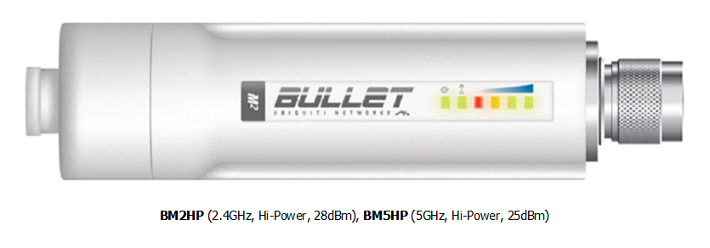
Bullet:
Bullet M is the latest version of the popular Ubiquiti Bullet. Like its predecessor, Bullet M is a wireless radio with an integrated Type N RF connector that can be directly plugged in to any antenna to create a powerful and robust outdoor Access Point, Client, or Bridge.

Slide 35
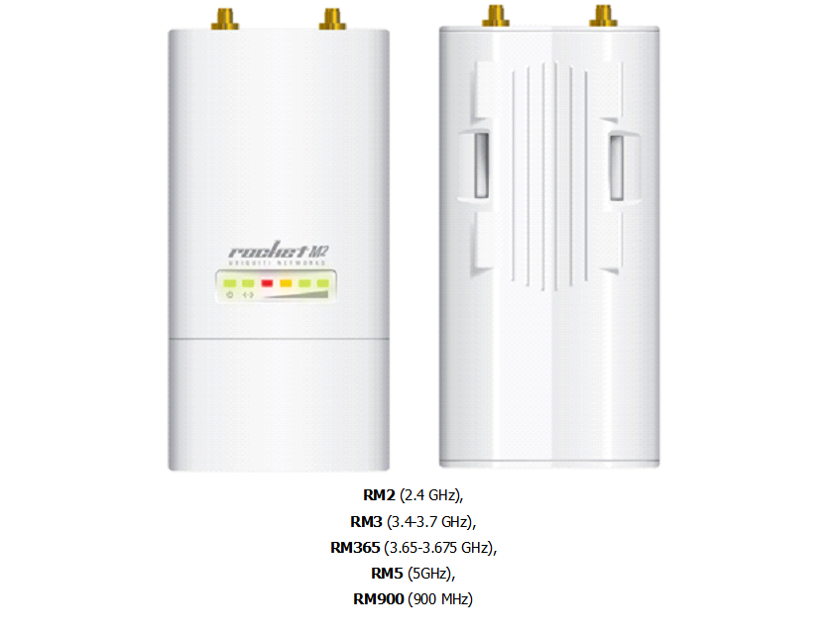
Rocket:
Rocket M is a rugged, hi-power, very linear 2x2 MIMO radio with enhanced receiver performance. It features incredible range performance (50+km) and breakthrough speed (150+Mbps real TCP/IP).

Slide 36
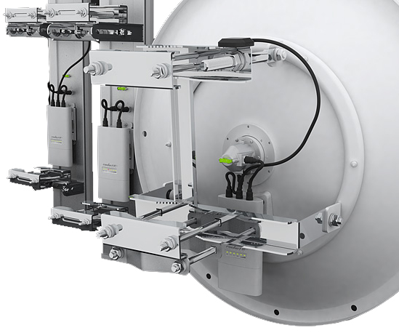
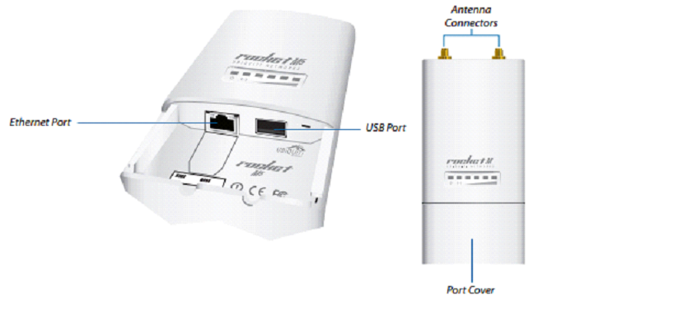
Rocket with dish and its specification:

Slide 37
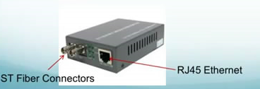
Fiber media converter:
A fiber media converter is a simple networking device that makes it possible to connect two dissimilar media types such as twisted pair with fiber optic cabling.

Slide 38
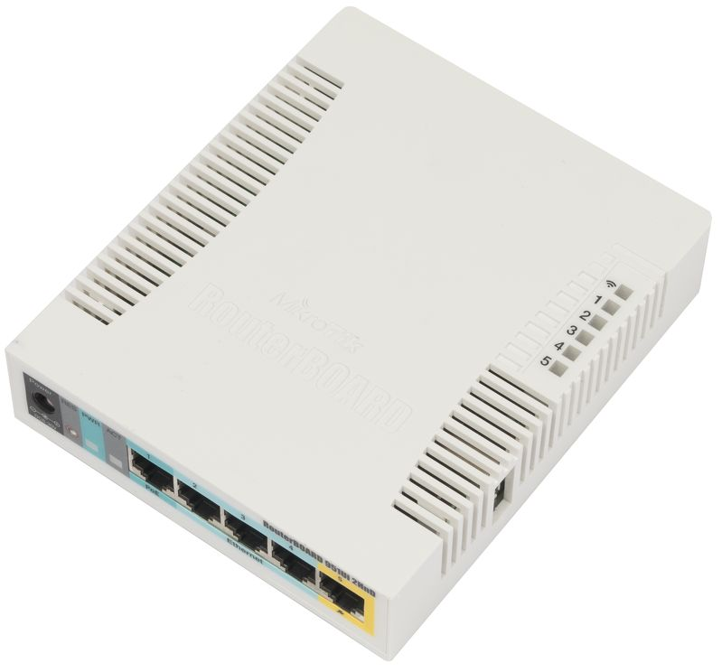
Router:
A router is an internetworking device that forwards packets between networks by processing the routing information included in the packet or datagram (Internet protocol information from layer 3). The routing information is often processed in conjunction with the routing table (or forwarding table). A router uses its routing table to determine where to forward packets.

Slide 39
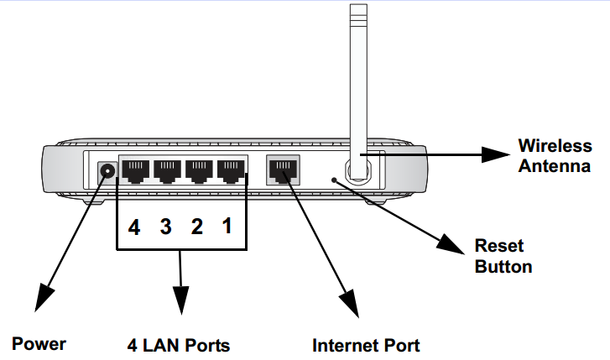
Wireless Router:
Wireless router (Netgear) works both as a router and wireless access point to the client. From its switch port, 4 pc can be connected without any external switch port. It has wireless antenna. So, a pc or laptop can be connected without wire.

Slide 40
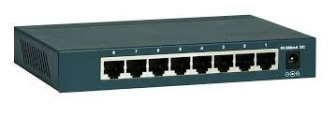
Switch:
A network switch is a device that forwards and filters OSI layer 2 datagrams between ports based on the MAC addresses in the packets.
Repeater and hub:
A repeater is an electronic device that receives a network signal, cleans it of unnecessary noise, and regenerates it.
In star topology, every device has a dedicated point to point link to a the central controller, it is known as hub.

Slide 41
SFP:
ODF:
ODF stands for optical distribution frame. It is a passive device which terminates cable and allowing arbitrary interconnections to be made. Optical fiber is housed in it.
It is a modular which is used to provide fiber optic connectivity to the client. It can be used instead of media converter in a network.
E1:
It is a physical device for data transmission. E1 carries signals at 2 Mbps.

Slide 42
TJB:
TJB box is a junction point of fiber patch cord and overhead or underground transmission and reception line.
STM:
The STM-1 (Synchronous Transport Module level-1) is the SDH ITU-T fiber optic network transmission standard. It has a bit rate of 155.52 Mbit/s.

Slide 43
Configuring:
Configuring a device means making a device active in a network. Without configuring, in a network a device cannot be activated for operation. To establish an active network, most of the physical devices are needed to be configured.
Before configuring a device, NIC has to be configured also by providing a static IP or it can get an IP from DHCP server.

Slide 44
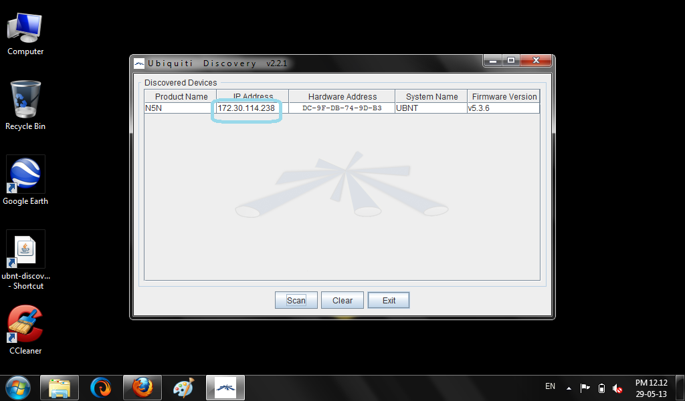
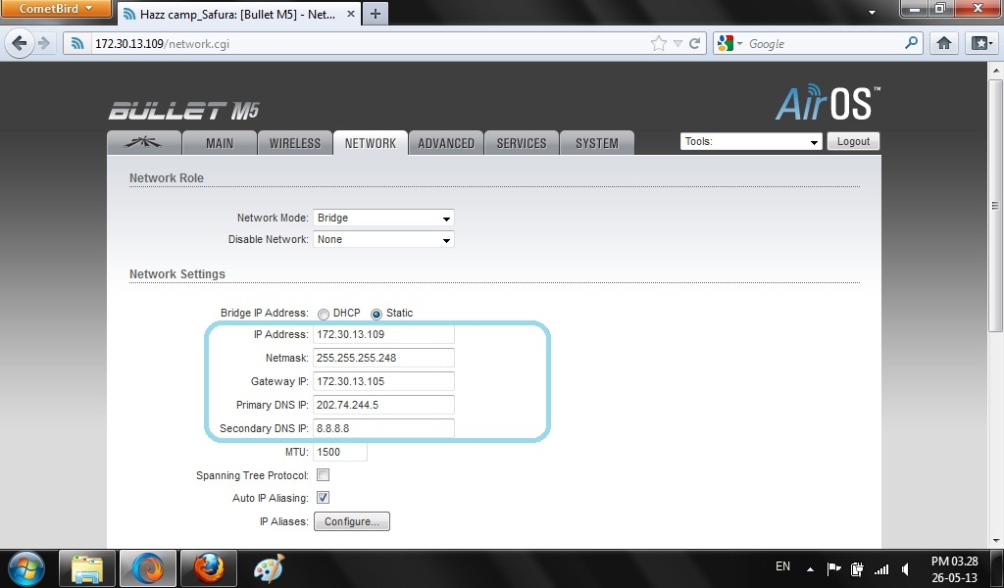
Configuring a radio device:

Slide 45
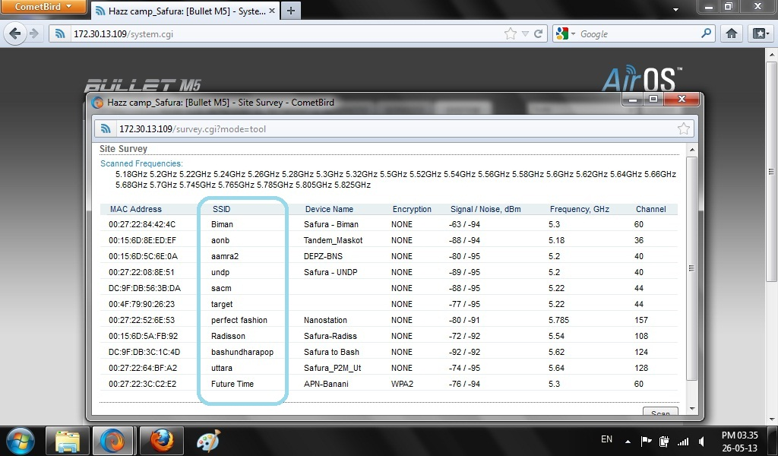
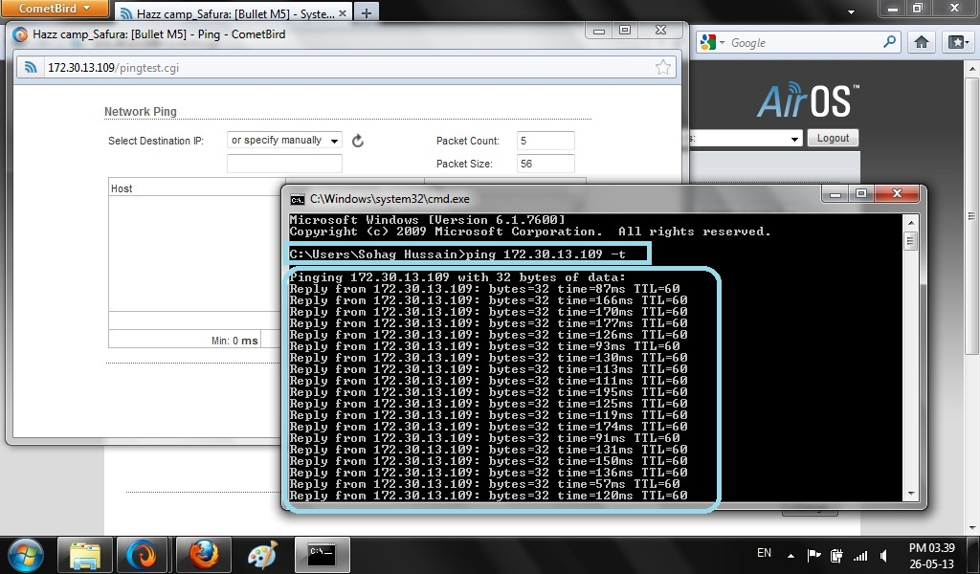
Configuring a radio device:

Slide 46
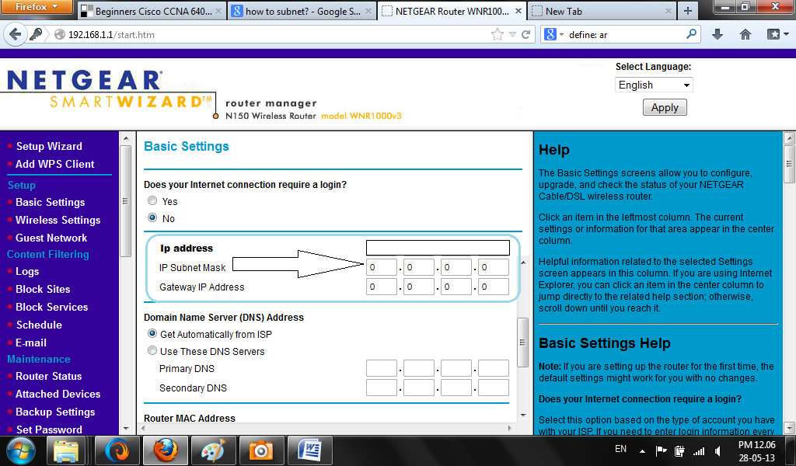
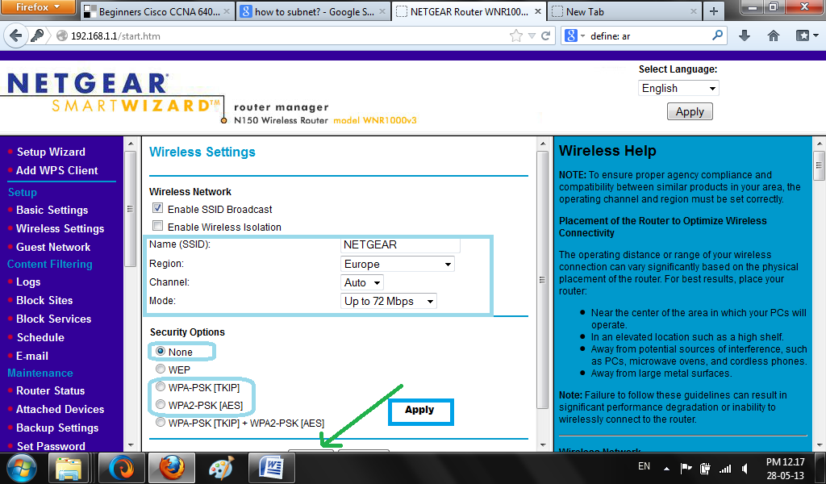
Configuring a wireless router:

Slide 47
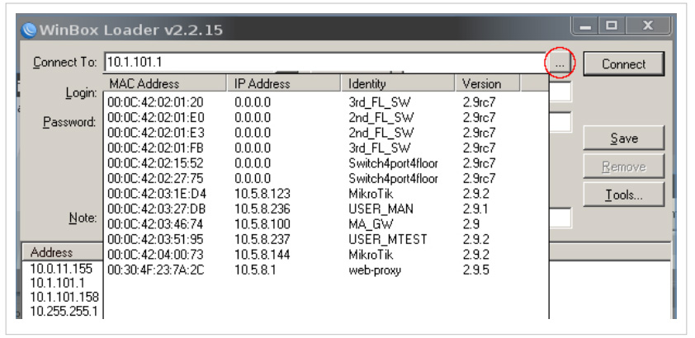
Configuring a microtik router:
Indicating a network or show route for communication
Indicating port for connection
Checking connection

Slide 48
Network monitoring in ANL

Slide 49
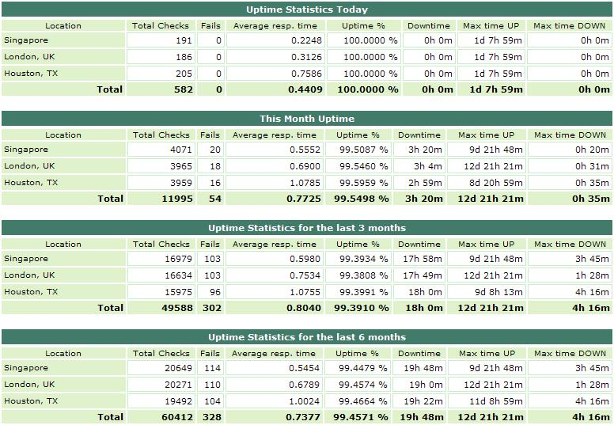
Network status monitoring:

Slide 50
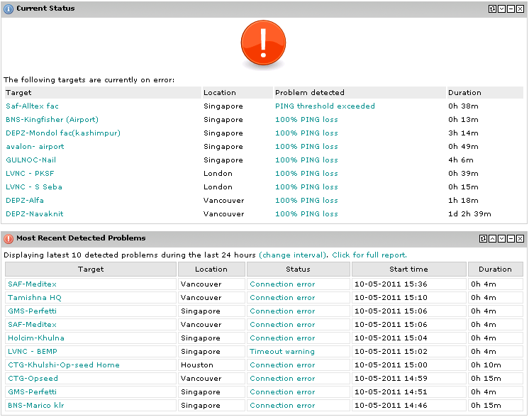
Network monitoring dash-board:

Slide 51
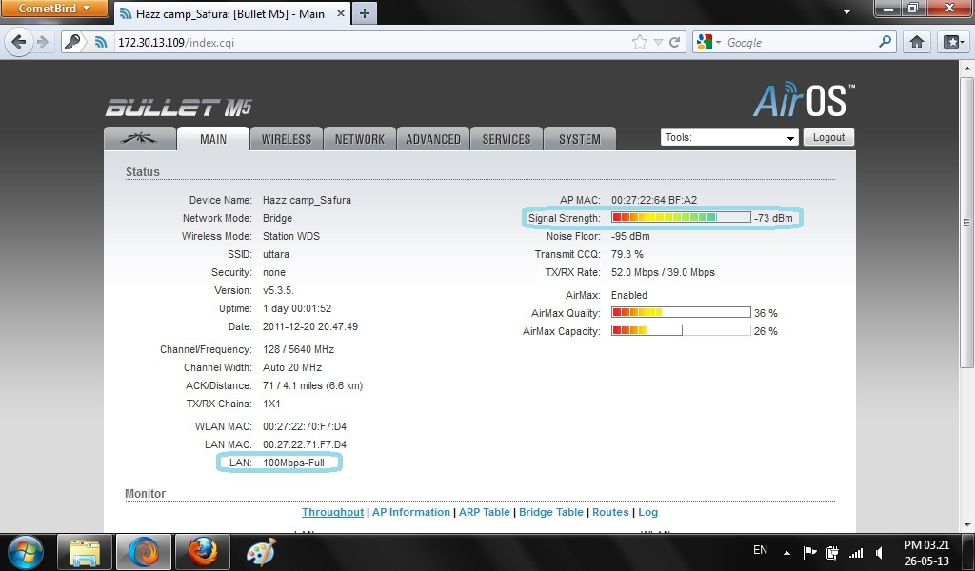
Radio device monitoring:

Slide 52
Router checking:
tracert
nslookup
netstat
Ping loss checking
Identifying active switch port for connection
Showing route of data communication
Download and upload speed checking:
DU meter is used for that. For LAN or wireless settings, it needs to be configured properly.

Slide 53
Fiber monitoring:
TX side, RX side and Power side monitoring : If TX side of media converter is turned off, then the problem is in fiber, If RX side is down, it means LAN is unplugged. If power is down, it means that the power of the device is turned off manually or automatically.
Power measuring by power meter: From K.M. Hafizur Rahman, Infrastructure Engineer, aamra networks ltd, it is known that -12 dbm is good power and if the power is greater than -35dbm, the power is not good
Checking the point by OTDR where cable is lost or disappeared.

Slide 54
Troubleshooting by ANL

Slide 55
Technical Support Flowchart:

Slide 56
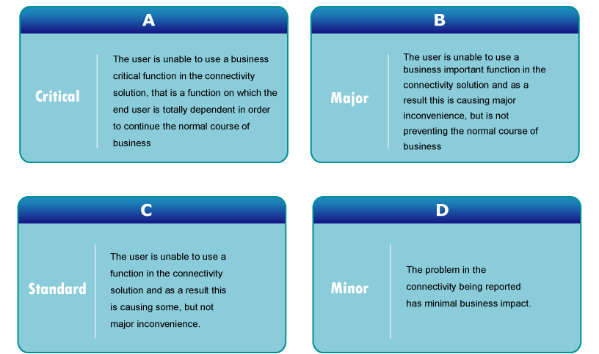
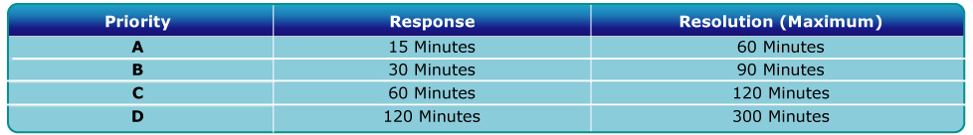
Target response and resolution time:
Support call prioritization:

Slide 57
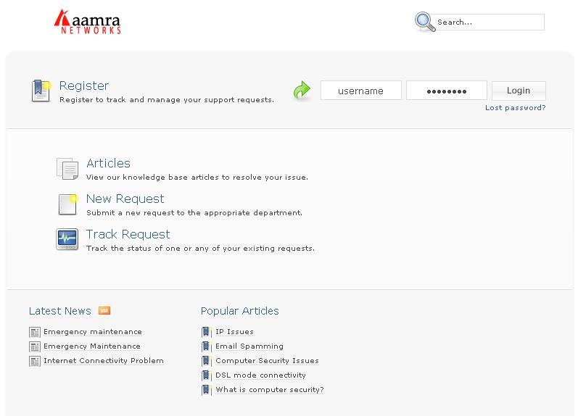
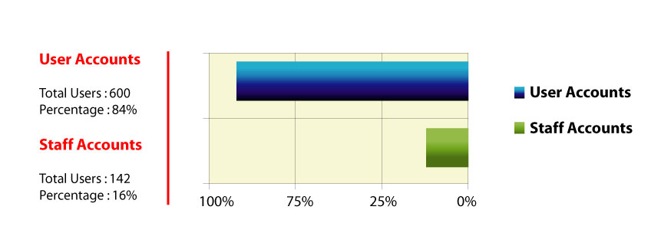
Customer Relationship Management (CRM):
Staff-Customer ratio:

Slide 58
Common troubles:
Radio device failure
Fiber cable loss
LAN unplugged
Power failure
Problem in radio alignment
Configuration problem
E1 down
Route changes or router resets
Wireless router failure
Radio cable problem
Connector problem
MC failures
Failure of Physical devices
Problem in frequency settings for outdoor radio
Miscellaneous problem

Slide 59
Solution:
If radio device fails, it should be rebooted and also it has to be configured again. If radio can not be found from LAN, it should be changed. New radio has to be aligned with POP radio so that it get better link. Then, new radio has to be configured according to the network.
To reduce fiber cable loss, underground transmission line can be used for internet connectivity. Overhead line has to be checked time to time. If any failure occurs, cable teams reaches quickly in that place and provide necessary amount of cable to regain internet connectivity.
If LAN is unplugged, then ANL informs its clients to plug in the LAN cable, thus they solve LAN unplugged problem.
ANL also solves power failure problem by providing inverter in their POP side. If the problem in clients side, their technicians go to clients side and connects the device again with power source to regain internet connectivity.
Radio alignment problem are resolved by tower man of ANL. They are experienced enough to make better link with another radio.

Slide 60
Solution:
If there is any configuration problem, ANL engineers take quick step to solve it. They can solve this problem from their office easily. If router resets or stop working, they also check the router and configure the router again to solve the problem.
If MC, connector, physical devices, cable, power cable or power strips fails, they instantaneously change those and regain internet connectivity.

Slide 61
Recommendation:
ANL needs at least one more team for their fiber department. They should also split fiber team into two categories. One is for new installation and another is for troubleshooting.
ANL should emphasis on R & D department. They have to spend more for this department so that they can know about new physical devices and their implementation.
Senior engineers of ANL are very experienced. If ANL trains its junior engineers by them for two or three days in a week, the juniors can work lot quicker than now.
Management should have to monitor the average response time for each problem and rewarded those person who employ the less amount of time to resolve a problem.

Slide 62
Conclusion:
Before establishing a network, basics of networking have to be understood. In this presentation, all of the basics, like- network properties, network criterion, topology, category, communication protocol, devices etc are discussed. They also need to tested with virtual tools. To ensure better service, all devices have to be monitored always and if any fault occurs, they need to be solved as soon as possible. Only then clients of ISP will be satisfied with the service.

Slide 63
Do you have any question?

Slide 64
Thank you

